Slide 1
GRADE 7 ACCELERATED · UNIT 4 · LESSON 6
Order of Operations with Radicals
MA.8.NSO.1.7
I can evaluate a multi-step expression with rational numbers, exponents and radicals by reading its structure.
Grade 7 Accelerated · Unit 4 · Lesson 6 — Order of Operations with Radicals
1

Slide 2
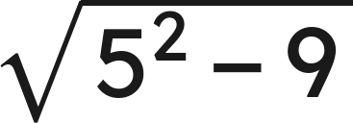
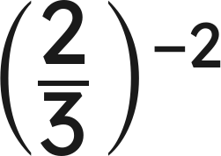

Warm-Up
1.
2. How many significant digits are in 1.020 ?
3. Find the value:
4. Evaluate:
Grade 7 Accelerated · Unit 4 · Lesson 6 — Order of Operations with Radicals
2

Slide 3
Warm-Up
1.
4
2. How many significant digits are in 1.020 ?
4
3. Find the value:
9/4
4. Evaluate:
8
Grade 7 Accelerated · Unit 4 · Lesson 6 — Order of Operations with Radicals
3

Slide 4
Notes
I. The structure, not a mnemonic
 | Level | What it means
1 | Grouping symbols | ( ), [ ], the radical bar, the fraction bar
2 | Powers and roots | the same level as each other
3 | Multiply and divide | left to right
4 | Add and subtract | left to right
Innermost grouping symbol first, then out.
Grade 7 Accelerated · Unit 4 · Lesson 6 — Order of Operations with Radicals
4

Slide 5


Notes
II. Left to right means left to right
, never
, never
Multiplication and division are one level. Addition and subtraction are one level. Left to right, both times.
Grade 7 Accelerated · Unit 4 · Lesson 6 — Order of Operations with Radicals
5

Slide 6
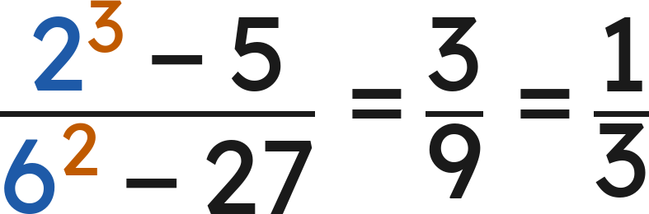
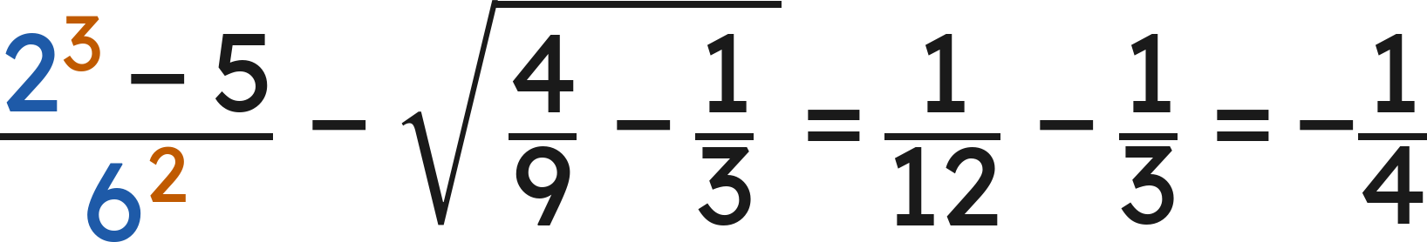
Notes
III. The fraction bar groups, top and bottom
Finish the numerator and finish the denominator before you divide.
Grade 7 Accelerated · Unit 4 · Lesson 6 — Order of Operations with Radicals
6

Slide 7
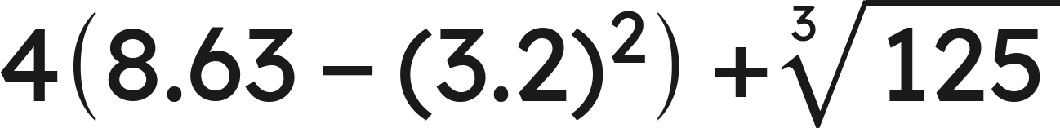
Example 1
Evaluate.
Grade 7 Accelerated · Unit 4 · Lesson 6 — Order of Operations with Radicals
7

Slide 8
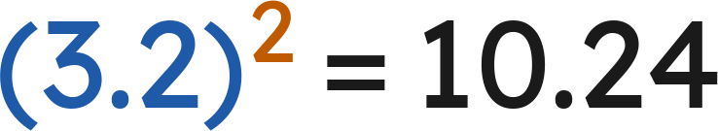
Example 1
Answer: −1.44
Grade 7 Accelerated · Unit 4 · Lesson 6 — Order of Operations with Radicals
8

Slide 9
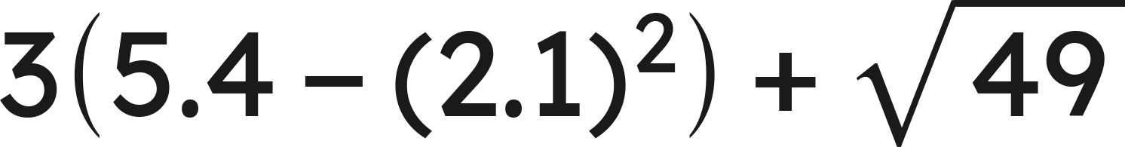
Your Turn
Evaluate.
Grade 7 Accelerated · Unit 4 · Lesson 6 — Order of Operations with Radicals
9

Slide 10
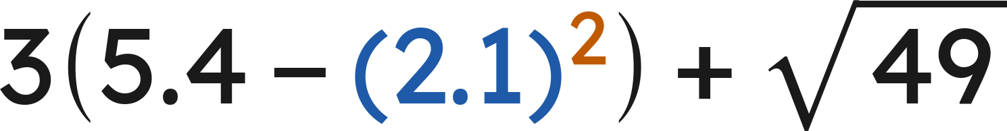
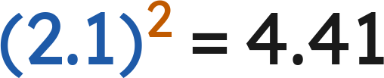
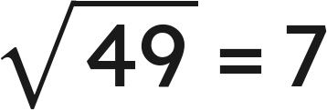

Your Turn
Evaluate.
Powers and roots:
and
Inside the parentheses:
Answer: 9.97
Grade 7 Accelerated · Unit 4 · Lesson 6 — Order of Operations with Radicals
10

Slide 11
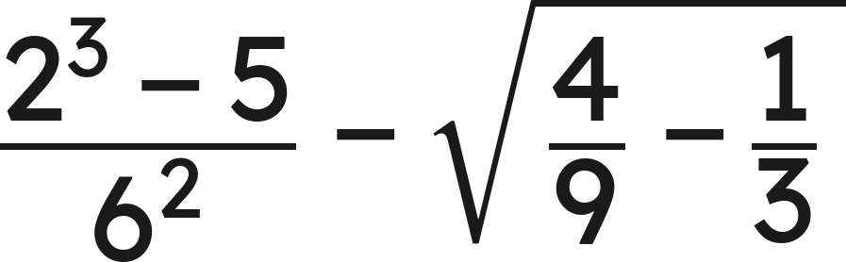
Example 2
Evaluate.
Grade 7 Accelerated · Unit 4 · Lesson 6 — Order of Operations with Radicals
11

Slide 12
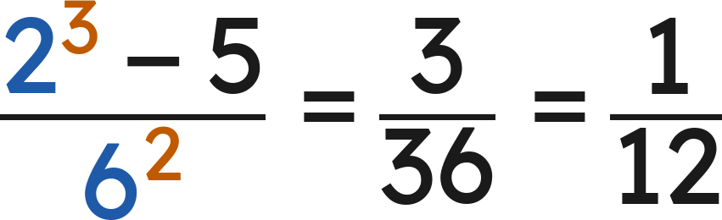
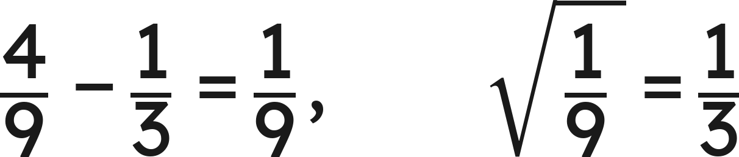
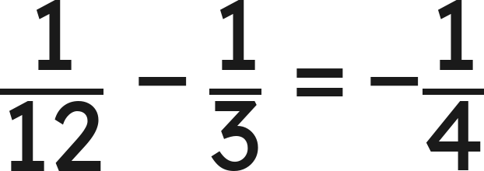
Example 2
Answer: −1/4
Grade 7 Accelerated · Unit 4 · Lesson 6 — Order of Operations with Radicals
12

Slide 13
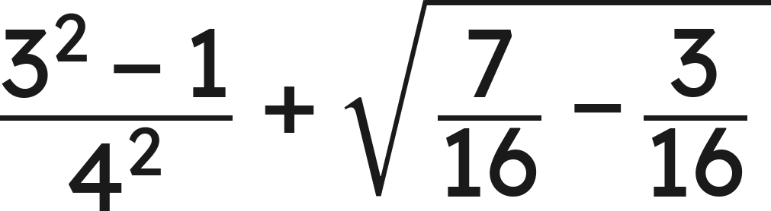
Your Turn
Evaluate.
Grade 7 Accelerated · Unit 4 · Lesson 6 — Order of Operations with Radicals
13

Slide 14
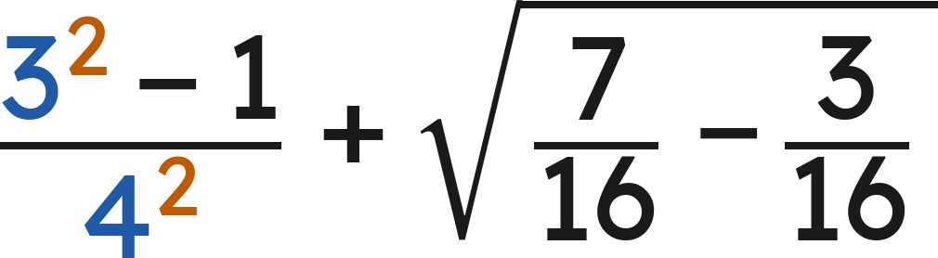
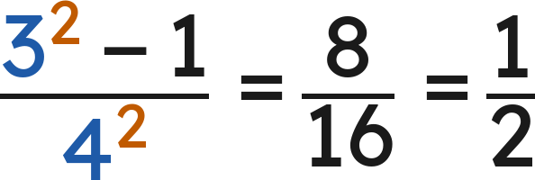
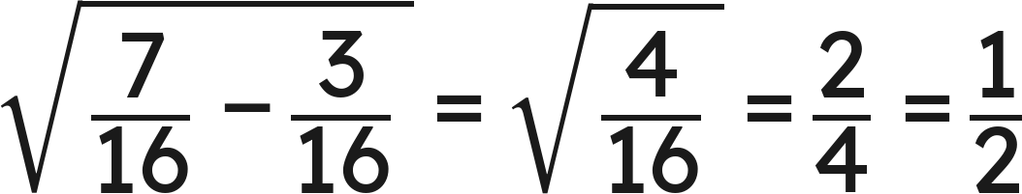
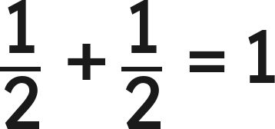
Your Turn
Evaluate.
Answer: 1
Grade 7 Accelerated · Unit 4 · Lesson 6 — Order of Operations with Radicals
14

Slide 15

Whiteboards · Question 1 of 9
Answer it.
Grade 7 Accelerated · Unit 4 · Lesson 6 — Order of Operations with Radicals
15

Slide 16



Whiteboards · Question 1 of 9
Left to right:
Answer: 8
Grade 7 Accelerated · Unit 4 · Lesson 6 — Order of Operations with Radicals
16

Slide 17
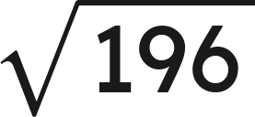
Whiteboards · Question 2 of 9
A square tile has side
centimeters.
Its diagonal is about 19.8 centimeters.
What is the perimeter of the tile?
Answer it.
Grade 7 Accelerated · Unit 4 · Lesson 6 — Order of Operations with Radicals
17

Slide 18

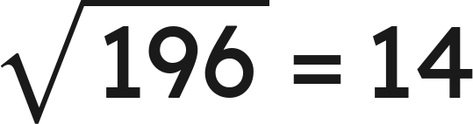

Whiteboards · Question 2 of 9
A square tile has side
centimeters.
Its diagonal is about 19.8 centimeters.
What is the perimeter of the tile?
Perimeter:
Answer: 56 centimeters
Grade 7 Accelerated · Unit 4 · Lesson 6 — Order of Operations with Radicals
18

Slide 19

Whiteboards · Question 3 of 9
Answer it.
Grade 7 Accelerated · Unit 4 · Lesson 6 — Order of Operations with Radicals
19

Slide 20


Whiteboards · Question 3 of 9
Left to right:
Answer: 9
Grade 7 Accelerated · Unit 4 · Lesson 6 — Order of Operations with Radicals
20

Slide 21
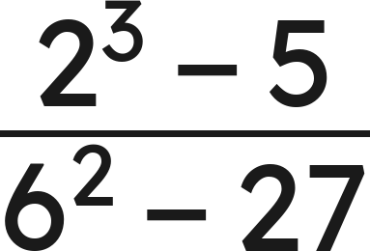
Whiteboards · Question 4 of 9
Answer it.
Grade 7 Accelerated · Unit 4 · Lesson 6 — Order of Operations with Radicals
21

Slide 22
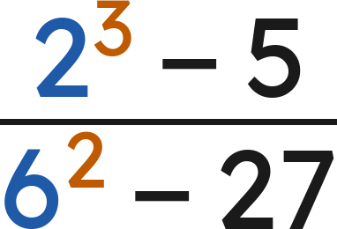


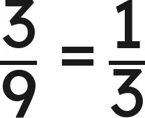
Whiteboards · Question 4 of 9
Top:
Bottom:
Answer: 1/3
Grade 7 Accelerated · Unit 4 · Lesson 6 — Order of Operations with Radicals
22

Slide 23
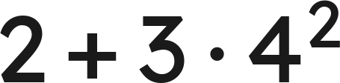
Whiteboards · Question 5 of 9
Which is the value?
A. 146
B. 50
C. 26
D. 80
Answer it.
Grade 7 Accelerated · Unit 4 · Lesson 6 — Order of Operations with Radicals
23

Slide 24
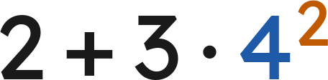



Whiteboards · Question 5 of 9
Which is the value?
Power first:
Then multiply:
Then add:
Answer: B — 50
Grade 7 Accelerated · Unit 4 · Lesson 6 — Order of Operations with Radicals
24

Slide 25
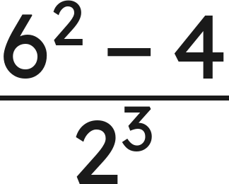
Whiteboards · Question 6 of 9
Which is the value?
A. 4
B. 35.5
C. 0.5
D. 256
Answer it.
Grade 7 Accelerated · Unit 4 · Lesson 6 — Order of Operations with Radicals
25

Slide 26
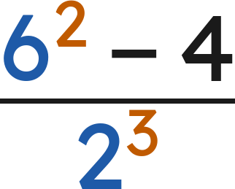



Whiteboards · Question 6 of 9
Which is the value?
Top:
Bottom:
Answer: A — 4
Grade 7 Accelerated · Unit 4 · Lesson 6 — Order of Operations with Radicals
26

Slide 27
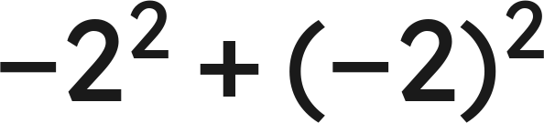
Whiteboards · Question 7 of 9
Answer it.
Grade 7 Accelerated · Unit 4 · Lesson 6 — Order of Operations with Radicals
27

Slide 28
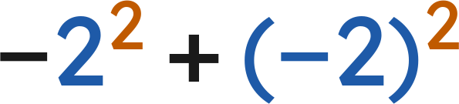

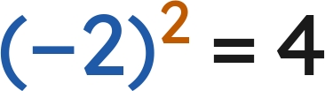

Whiteboards · Question 7 of 9
(the exponent is on the 2 only)
Answer: 0
Grade 7 Accelerated · Unit 4 · Lesson 6 — Order of Operations with Radicals
28

Slide 29
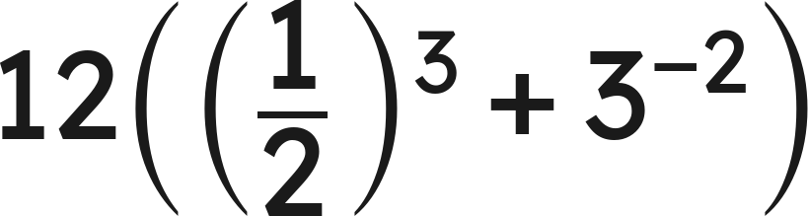
Whiteboards · Question 8 of 9
Answer it.
Grade 7 Accelerated · Unit 4 · Lesson 6 — Order of Operations with Radicals
29

Slide 30
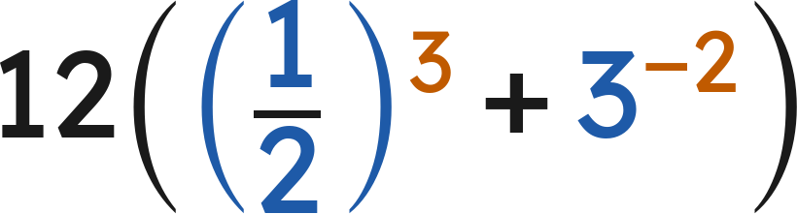
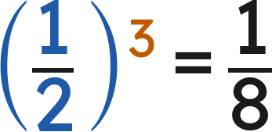
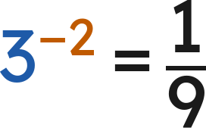
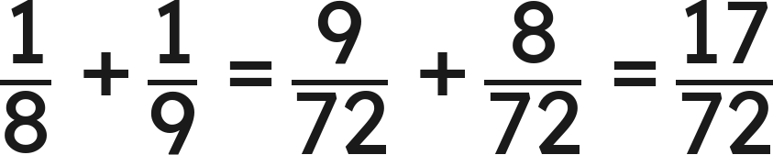
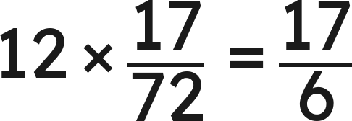
Whiteboards · Question 8 of 9
and
Answer: 17/6
Grade 7 Accelerated · Unit 4 · Lesson 6 — Order of Operations with Radicals
30

Slide 31
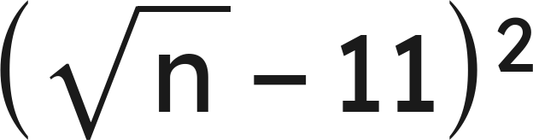

Whiteboards · Question 9 of 9
Roscoe says that
is always positive,
because a square is always positive.
Is he right? Give a value of
that settles it.
Write your answer in sentences.
Grade 7 Accelerated · Unit 4 · Lesson 6 — Order of Operations with Radicals
31

Slide 32


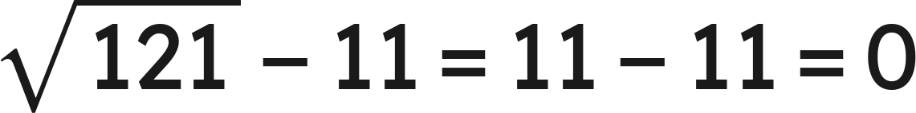

Whiteboards · Question 9 of 9
Roscoe says that
is always positive,
because a square is always positive.
Is he right? Give a value of
that settles it.
When
:
, and 0 is not positive.
Answer: No — at n = 121 the value is 0
Grade 7 Accelerated · Unit 4 · Lesson 6 — Order of Operations with Radicals
32

Slide 33


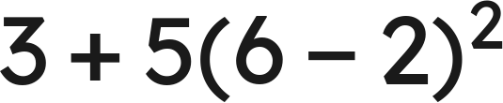
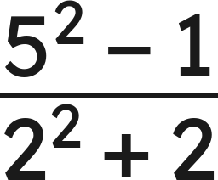
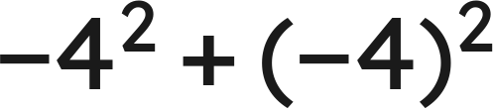
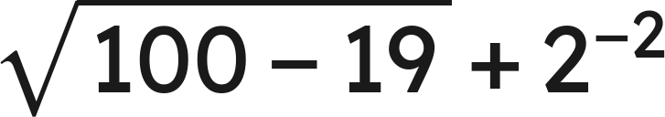
Independent Set
1.
2.
3.
4.
5.
6.
Grade 7 Accelerated · Unit 4 · Lesson 6 — Order of Operations with Radicals
33

Slide 34
IXL
1.
Open IXL and start today's skills.
2.
Work on paper where the question needs work. The answer box does not show it.
3.
Every skill listed is required, to a SmartScore of 67. Due at the start of the next class.
Today's skills — all required
Evaluate radical expressions — D8J
Grade 7 Accelerated · Unit 4 · Lesson 6 — Order of Operations with Radicals
34

